Slide 1
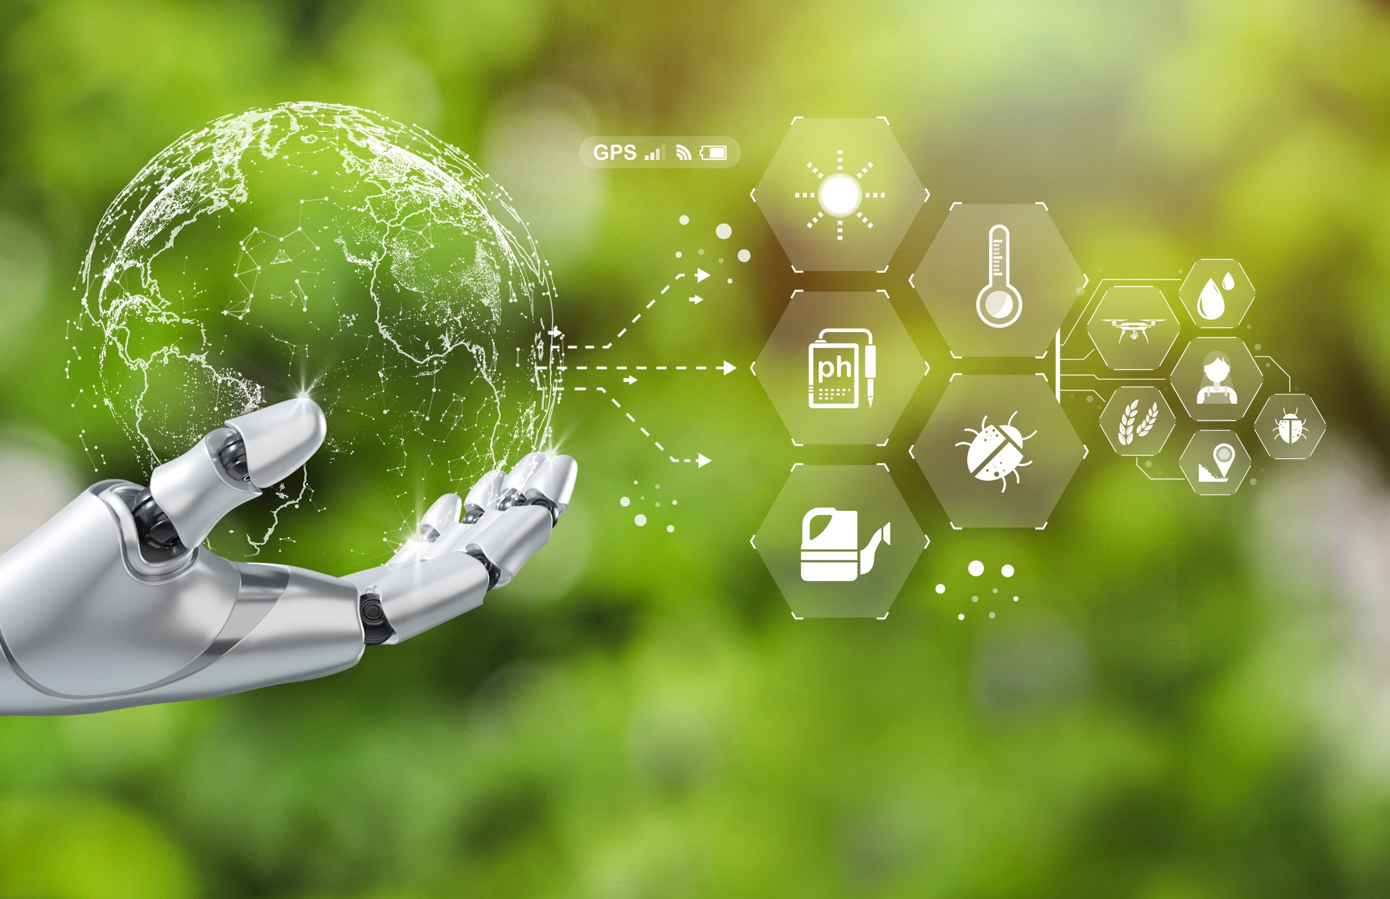
Problem Statement
Environment Sustainability
Climate change, pollution, and inefficient waste management are critical global issues. AI can play a crucial role in addressing these challenges by predicting climate change risks, monitoring environmental factors, and optimizing waste management.

Slide 2
Solution
AI-Powered Climate Risk Prediction: Implementation of machine learning models to analyze climate data and predict disasters like floods, droughts, and hurricanes.
Smart Waste Management: Using AI and IoT to detect, classify, and optimize waste collection and recycling processes.
Real-time Environmental Monitoring: To Deploy AI-based models to monitor air and water quality using sensors and cloud computing.

Slide 3
Tech Architect
[ User Uploads Image ]
⬇️
[ Azure Blob Storage ]
⬇️
[ Azure Function triggers Classification ]
⬇️
[ Azure Custom Vision API Classifies Waste ]
⬇️
[ Results Stored in Azure Table Storage ]
⬇️
[ Power BI Visualizes Trends ]

Slide 4
How is Microsoft Azure is used
Data Collection & Storage (Azure Blob Storage):
✅ Purpose: Store images of waste for classification ✅ Azure Service Used: Azure Blob Storage
AI Model for Waste Classification (Azure Custom Vision)
✅ Purpose: Classify waste into categories (Organic, Recyclable, etc.) ✅ Azure Service Used: Azure Custom Vision
Processing & Automation (Azure Functions)
✅ Purpose: Automate classification when a new image is uploaded ✅ Azure Service Used: Azure Functions (Serverless compute)
Data Storage & Logging (Azure Table Storage)
✅ Purpose: Store classification results ✅ Azure Service Used: Azure Table Storage

Slide 5
Tech Diagram, stack, github repo
Tech Stack
Languages: Python,
Frameworks: TensorFlow, Scikit-Learn, PyTorch
Cloud Services: Azure Functions, Storage, Custom Vision
Databases: Azure Cosmos DB
Github Repo:
https://github.com/Ayishak04/NatureNexus-Smart-Waste-Classifier-.git

Slide 6
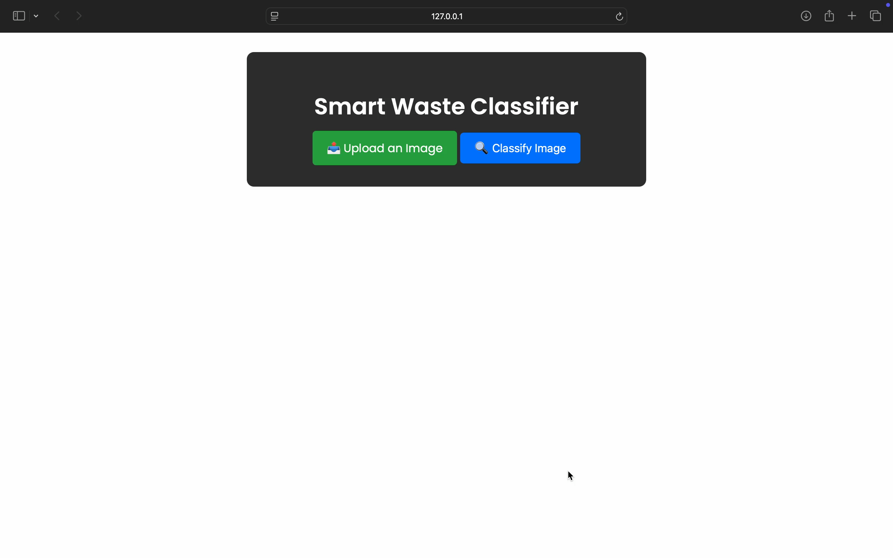
Demo

